Slide 1
GENDER,RELIGION & CASTE

Slide 2
RELIGION
GENDER
CASTE

Slide 3
MEANING OF GENDER
Social differences between
men & women

Slide 4
GENDER DIVISION
Gender division is a form of
hierarchical social division
every where
2. Hierarchical-
a) Graded organization/priestly
govt
b) A ladder- like formation in
which all the caste groups are
placed
3. It is a natural and unchangeable
4. It is not based on biology but on
social expectation

Slide 5
Social Hierarchy

Slide 6
SEXUAL DIVISION OF LABOUR
1. It means different working conditions of both men & women
2. A system women do all works inside the house & men do all the works outside the home

Slide 7
PUBLIC / PRIVATE GENDER DIVISION
Boys and girls are brought
up to believe that
A) The main responsibility
of woman is house
work/inside works
and
B) The main duty of men
outside works & earn
money for family
2. This is reflected in sexual
division of labour in families.

Slide 8
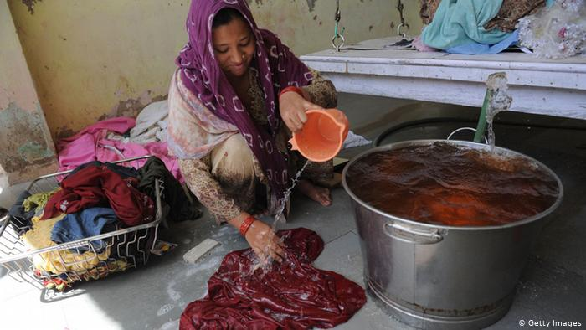
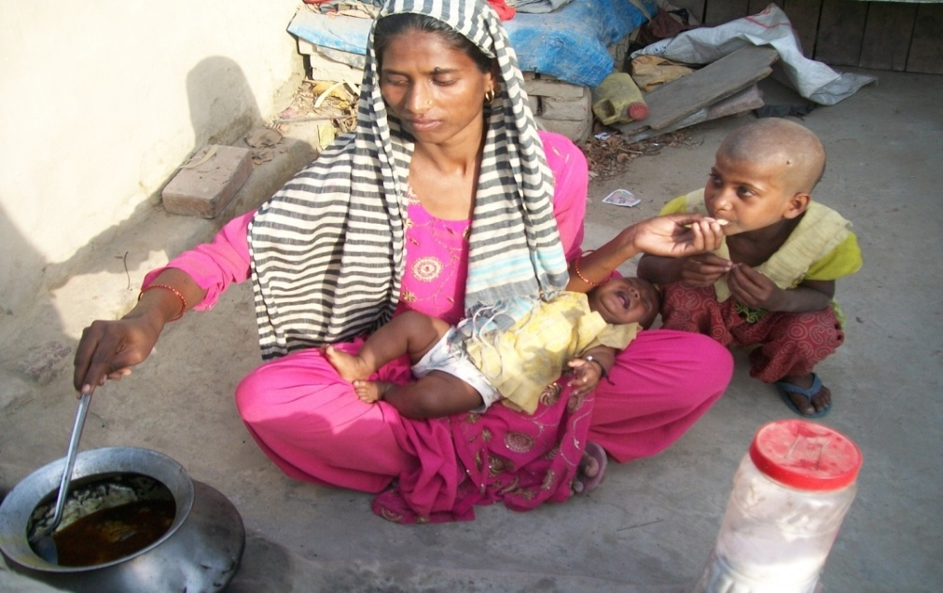
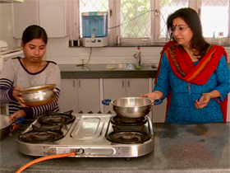
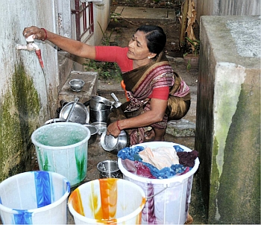
HOUSE WORKS OF WOMEN

Slide 9
3. Domestic work of
woman is not valued
and also not recognized.
4. The woman population
is about 50% but their
role in politics and public
life is minimum.
5. Woman organized
agitation for voting right.

Slide 10
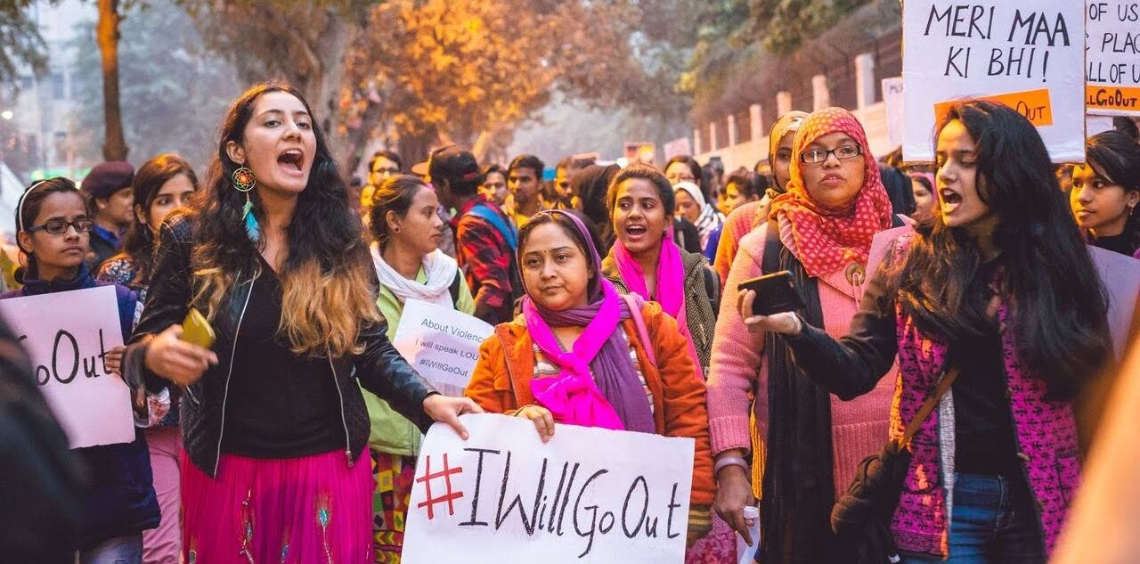
Feminist movement
Feminist- belief in the social, political and economic right for men and woman

Slide 11
Demands Feminist movement
A) It is an
agitation demanding voting right

Slide 12
Feminist movement
B) Enhancing
political
and legal
status

Slide 13
Feminist movement
Enhancing legal status

Slide 14
Feminist movement
C)Equality
in
personal
and
family
life

Slide 15
Woman Participation in public life
At present woman participation is more in the different fields
2. Ex-scientists, doctors,
engineers etc. of all
Scandinavian countries
woman participation is very
rich. (Sweden, Finland,
Norway)

Slide 16
PATRIARCHAL SOCIETY
Father is the head of the family in this society
OR
Male dominated society

Slide 17
How woman are discriminated/Diameters of gender inequalities
1. Low literacy rate
2. Higher studies
3. Highly paid woman job holders are
less.
4. The equal wage act
5. Preference to have sons
6. Proportion of woman in legislature
7. Decline in sex ratio
8. Harassment, Exploitation, Violence
against Woman are more in Urban
area
9. There is no safe place for woman

Slide 18
Higher studies

Slide 19
Measures taken to promote the proportion of women in Indian legislature –
Reservation of seats in
legislatures
Legal binding to have a fair proportion
C) Raising literacy rate

Slide 20
Measures taken to empower women
1. Seats are reserved for women in
legislatures
2. Girls education Promoted
3. Opportunities to work in various
fields
4. Women welfare commission has
been set up
5. Dowry act passed(1961) to ban it
6. Sex discrimination made illegal
7. Sthree Shakti & Mahila mandlies
organized
8. Special police stations also set up

Slide 21
Dowry act passed(1961) to ban it

Slide 22
COMMUNALISM
Treating a person belonging to one’s own religion as friends and other as enemies

Slide 23
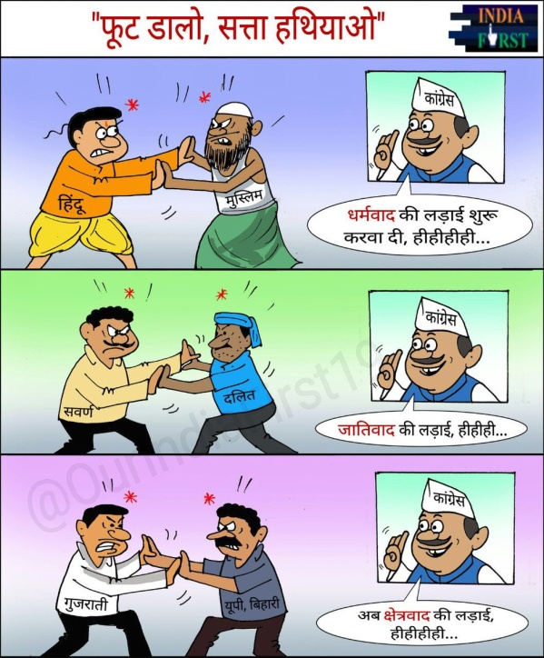
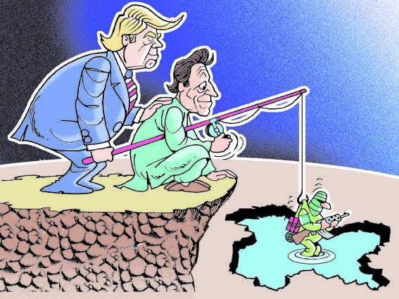
Causes for Communalism
1. British encouraged communal
politics –
a) Divide and rule police
b) Separate electorates
c) Separate identity
2. Economic backwardness
3. Fundamentalists
4. Communal medium , literature
5. Outside intervention like
Jammu and Kashmir

Slide 24
CASTE AND POLITICS
1. It is one of the social feature of India.
2. Caste system existing
based on ‘hereditary
occupation’
3. Marriages are formed within
the cast group
4. Inhuman practice of
‘untouchability’ occurred due to discrimination against the
“out cast” group
Caste system

Slide 25
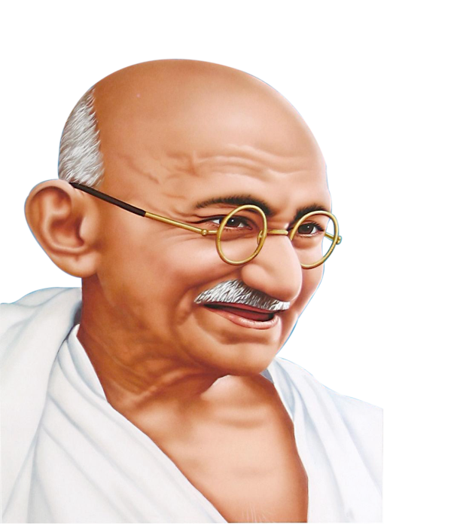
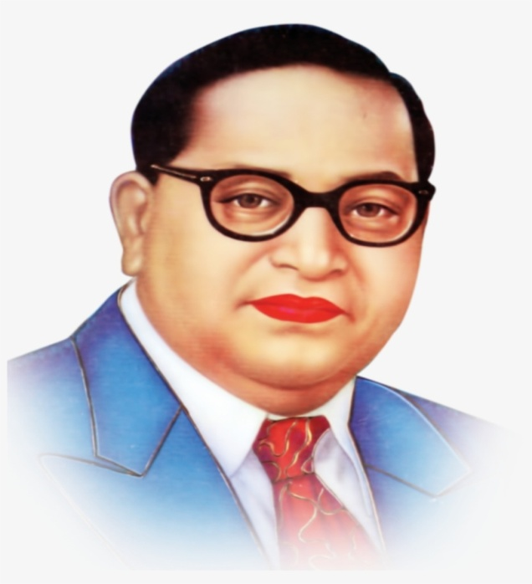
Social reformers
5. Social reformers like
i) Jyotiba phule
ii) Gandhiji,
iii) B.R.Ambedkar and
iv) Periyar ramaswamy etc
6. Tried to reduce caste
inequalities
7. Due to their efforts and due
to other ‘socio-economic’
changes, changes occurred
in caste system in India

Slide 26
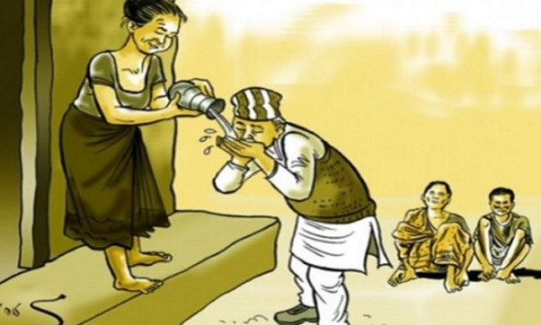
Cast inequalities
1. ‘Marriages’ performed
in the same castes.
2. People from different
castes do not interact
with each other
3. ‘Untouchability’ is still
present in some parts
4. Upper caste people who got
good education got top job
positions
5. Due to this they became
economically better

